Slide 1
Circles Bingo
Aim: Full House

Slide 2
Choose 9 to go in your grid
Chord 3.14 Diameter π
πr² 314cm² Circumference 10cm
Radius 34cm 31.4cm Segment
πD Sector 90⁰ Arc

Slide 3
The number of degrees in a quarter circle

Slide 4
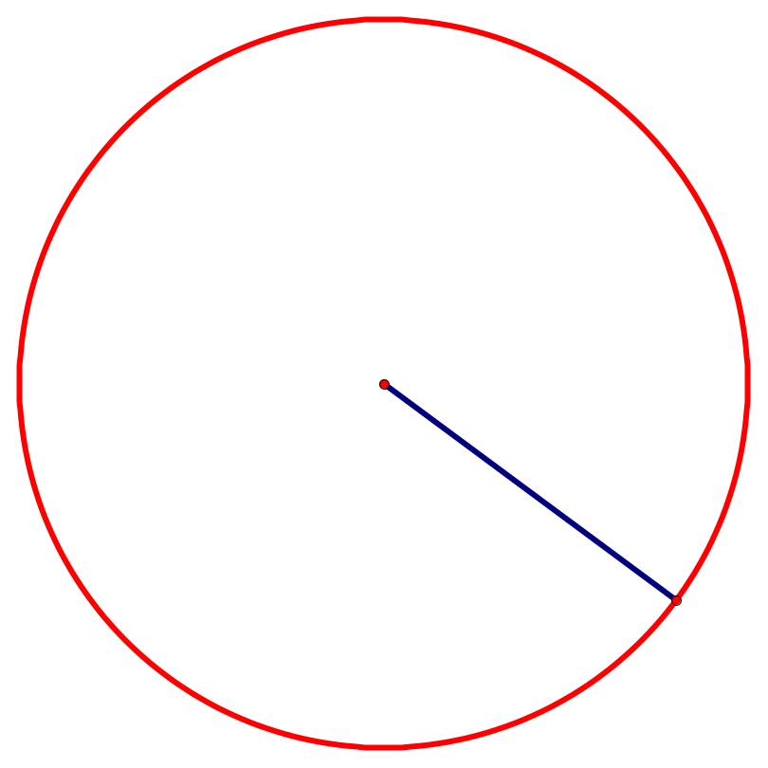
The length of the diameter of this circle
17cm

Slide 5
An estimate of pi

Slide 6
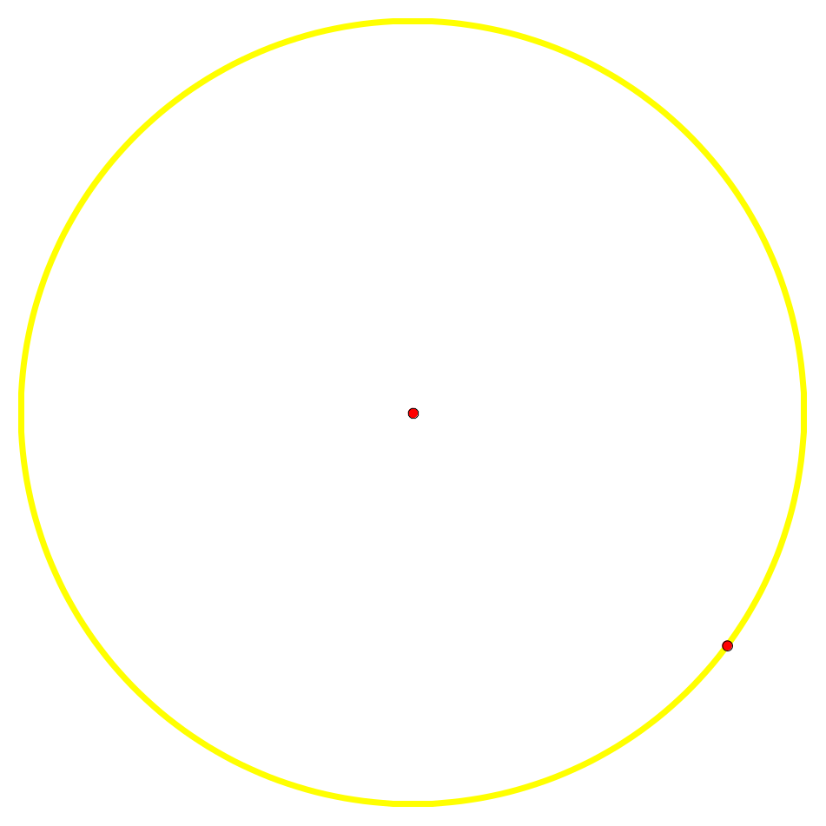
The name of the yellow part of this circle:

Slide 7
The formula for finding the area of a circle

Slide 8
The symbol for pi

Slide 9
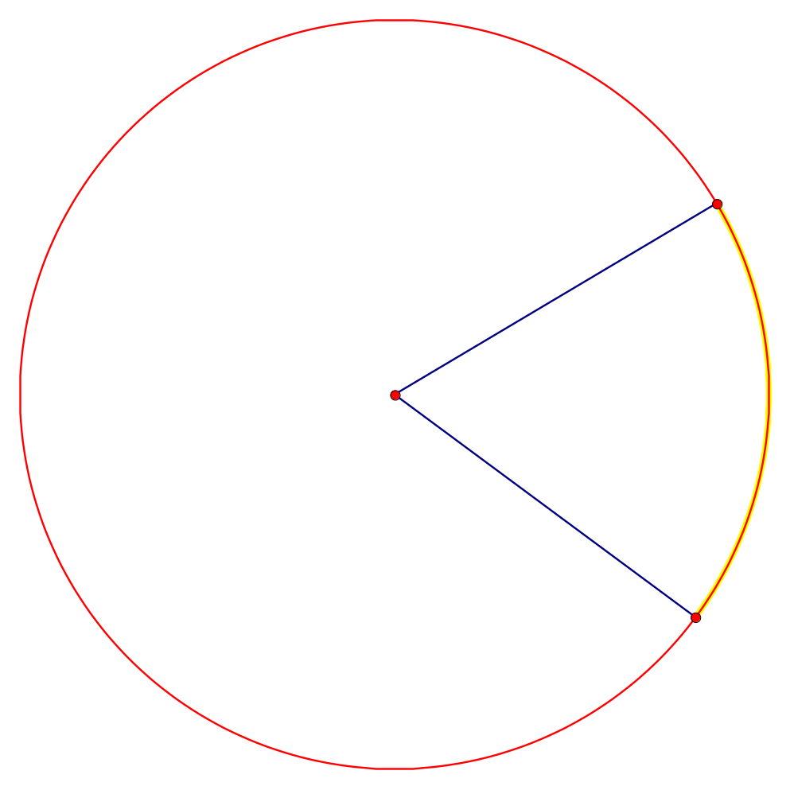
The name of the yellow part of this circle:

Slide 10

The Radius of this circle:
20cm

Slide 11
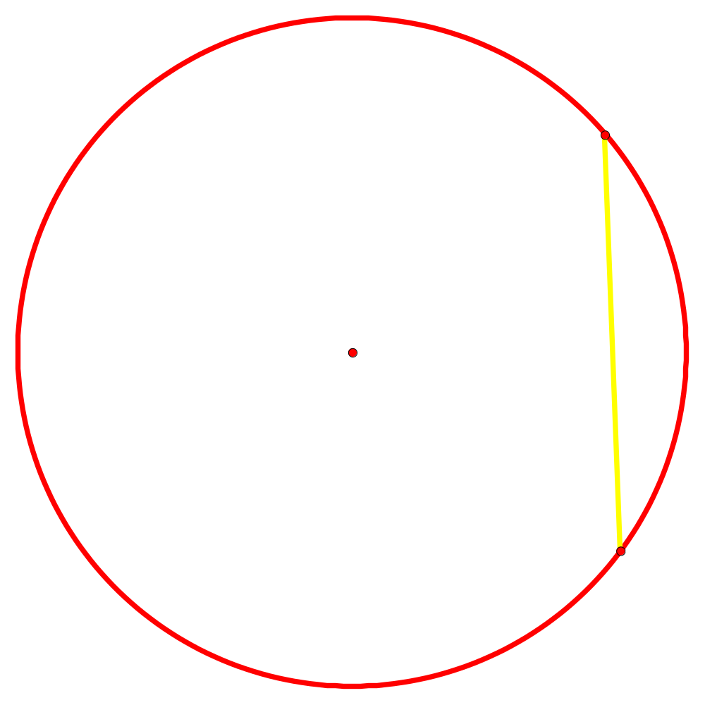
The name of the yellow part of this circle:

Slide 12
The formula for the circumference of a circle

Slide 13
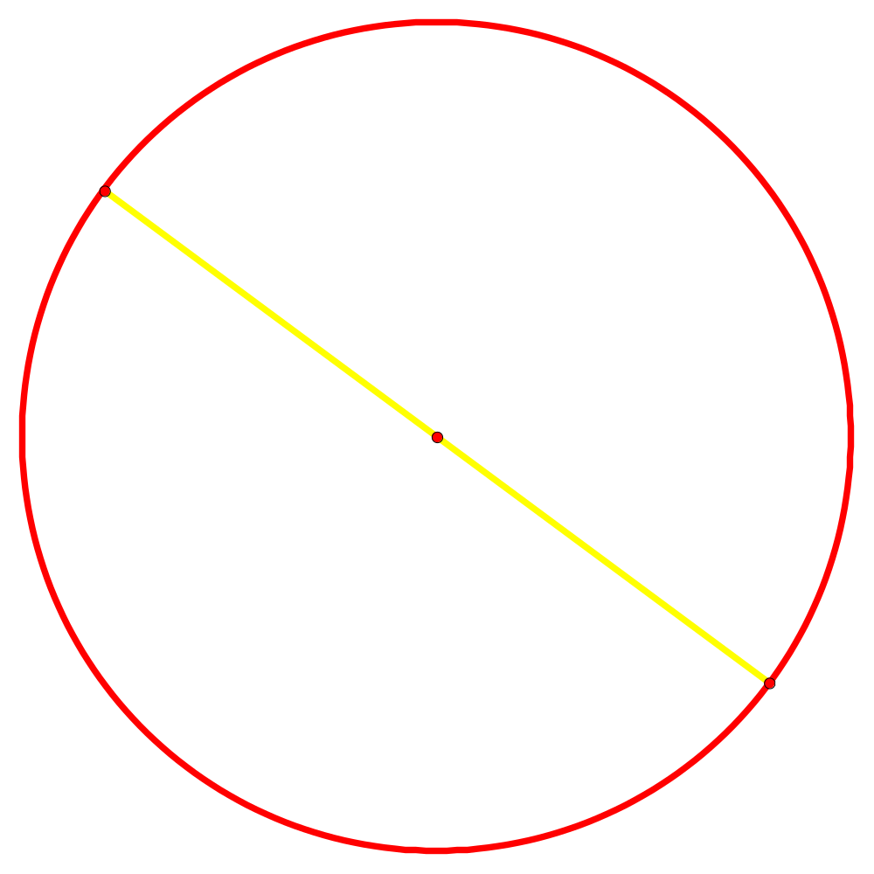
The name of the yellow part of this circle:

Slide 14
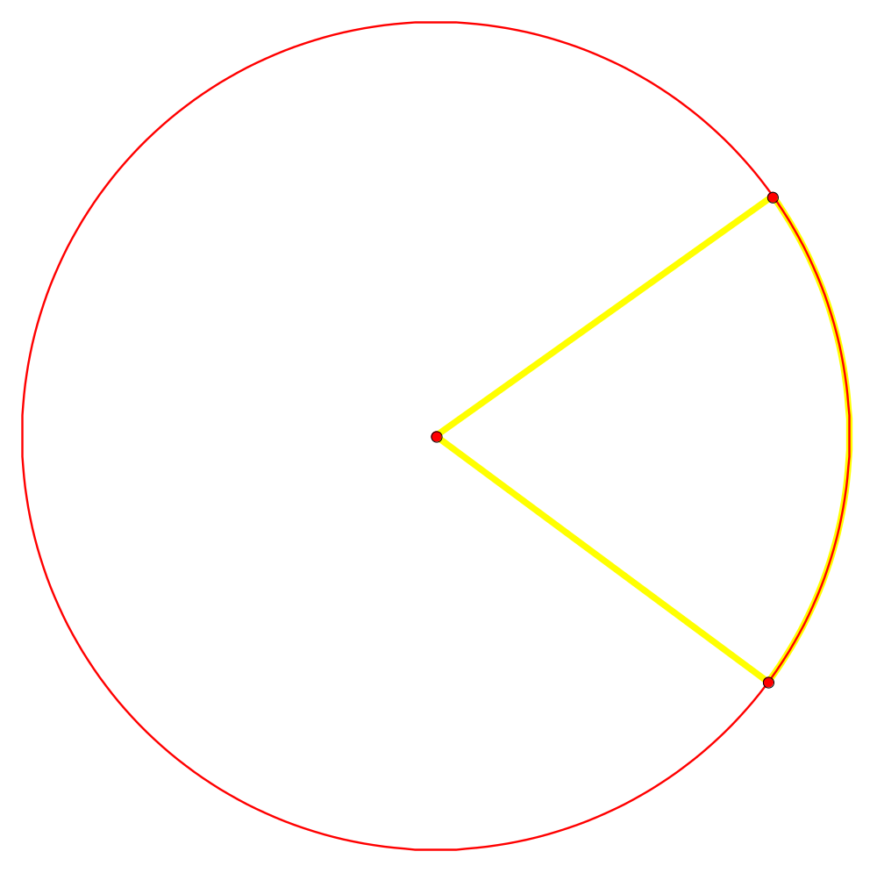
The name of the yellow part of this circle:

Slide 15
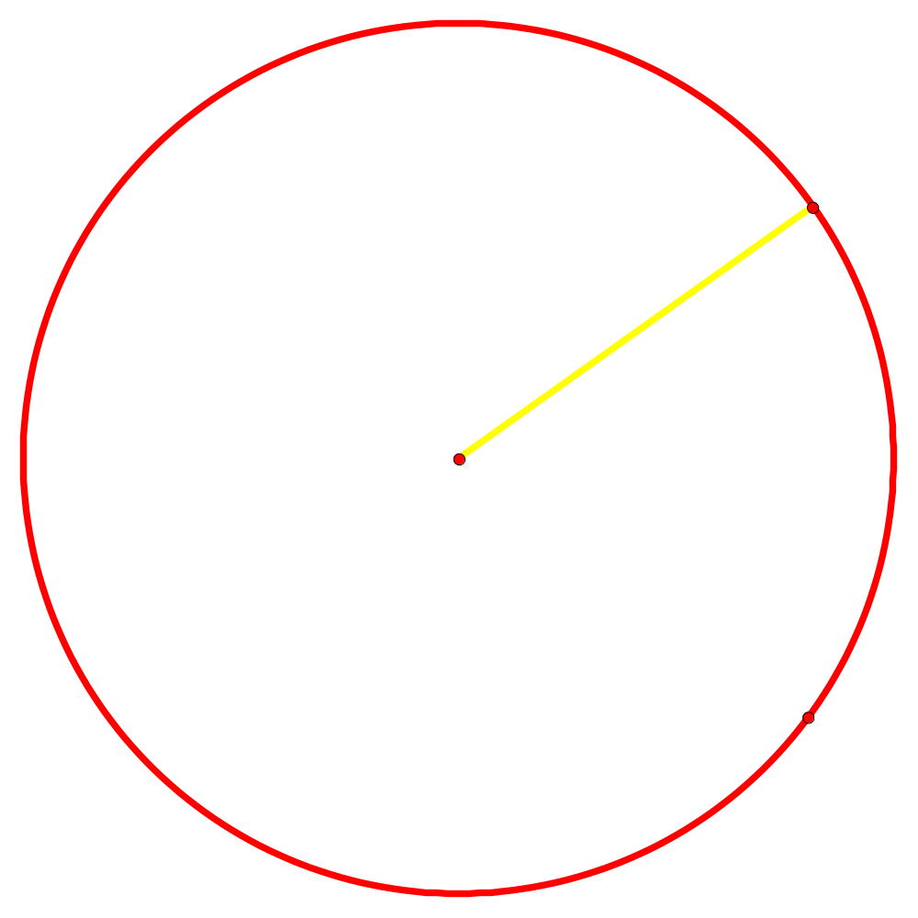
The name of the yellow part of this circle:

Slide 16
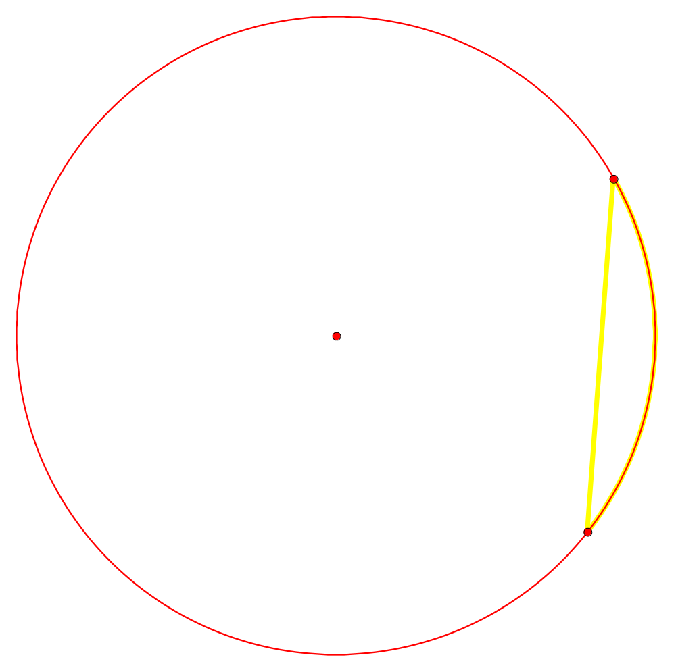
The name of the yellow part of this circle:

Slide 17
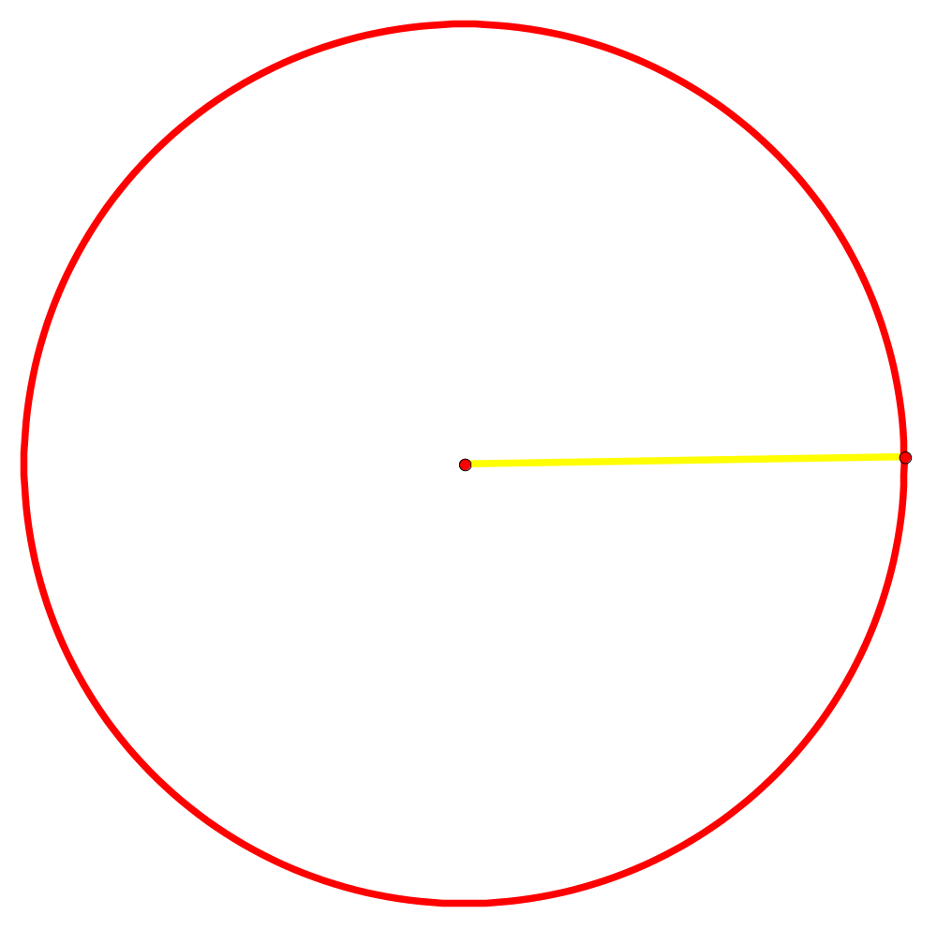
The area of this circle:
10cm

Slide 18
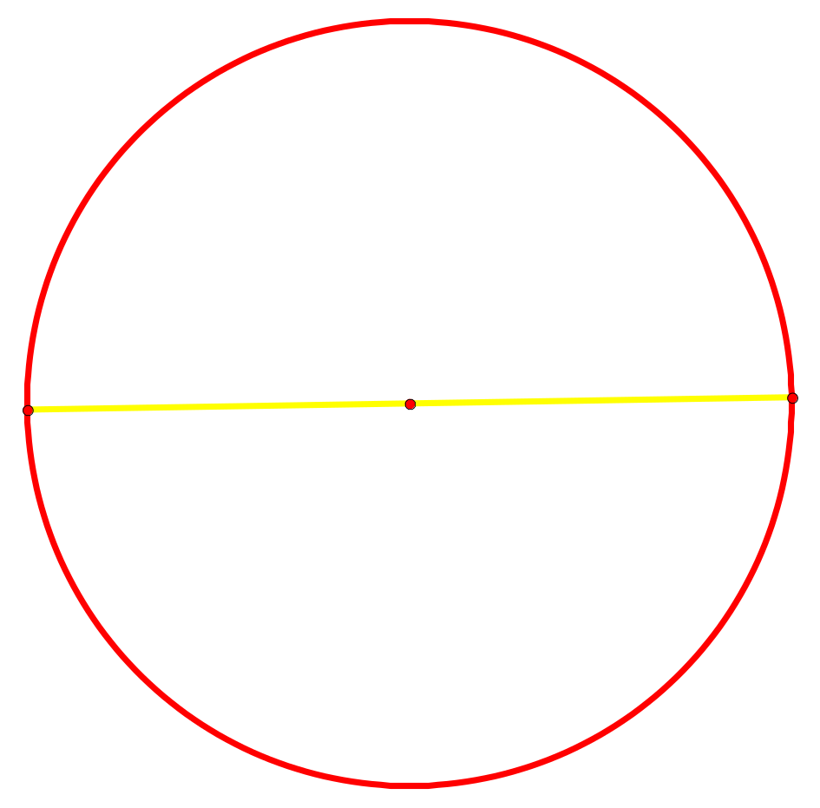
The circumference of this circle:
10cm

